Slide 1
HPGe MCNP Automated Parametric Optimization Model
Air Force Institute of Technology
6 December, 2017
Notes:
HPGes/Applications
NucE world modeling for everything
Some sources are hard to predict, models provide insight to make intelligent experimental decisions, cut costs, plausibility
Raise flags on possible detector issues
Future template for future exp. With this detector

Slide 2
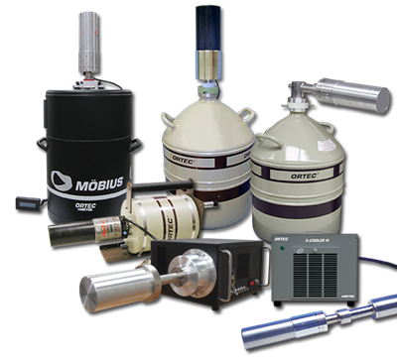
Overview
Project Goals
Previous Work
Experiment
MCNP Model
Parametric Optimization Code
Results
Conclusions
Future Work
Notes:
Goals, Lit, Exp, Model, optimize, results, conc.

Slide 3
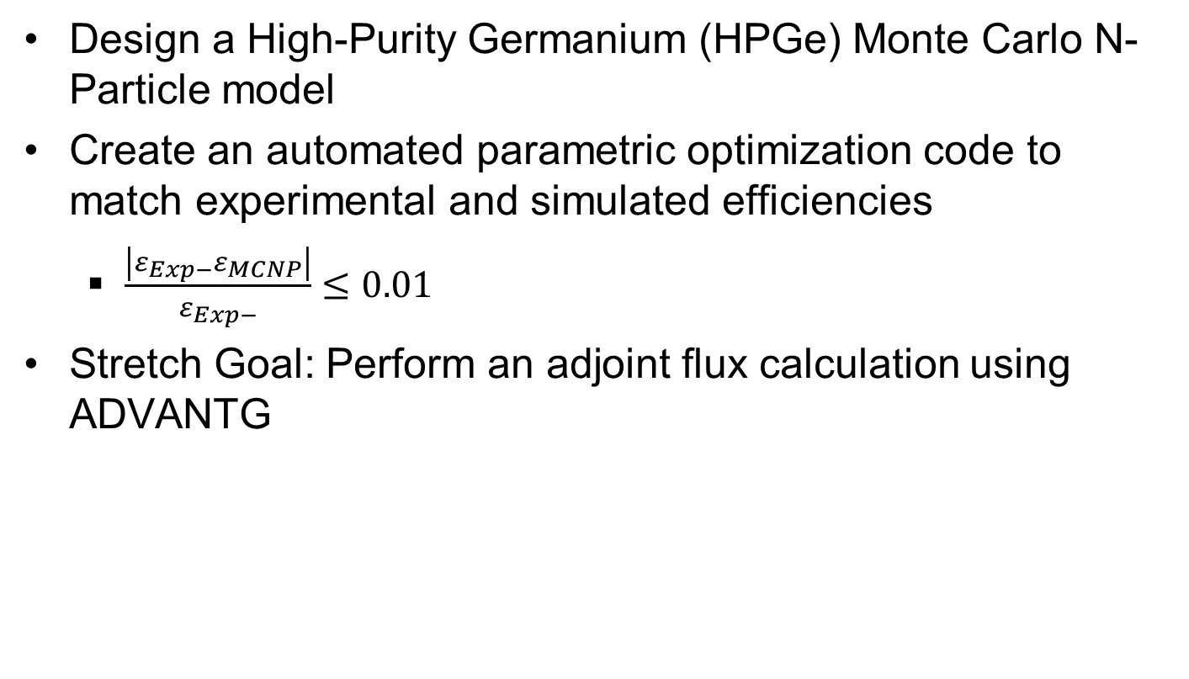
Project Goals
Design a High-Purity Germanium (HPGe) Monte Carlo N-Particle model
Create an automated parametric optimization code to match experimental and simulated efficiencies
$\frac{\left|ε_{Exp−}ε_{MCNP}\right|}{ε_{Exp−}}≤0.01$
Stretch Goal: Perform an adjoint flux calculation using ADVANTG
Notes:
Model
Automated Opitmizaiton
ADVANTG adjoint Flux calc

Slide 4
Previous Work
Manufacturer provided dimensions are often times not sufficient for developing models. ^{[1]}
Published relative differences between experimental and Monte Carlo simulated absolute efficiencies range from around 10% to as low as 0.2%. ^{[2][3]}
Dead layer thickness and the active volume may change over time. ^{[4]}
Notes:
Manufacturer issues
10-0.2% range
Deadlayer/Active Volume changes

Slide 5
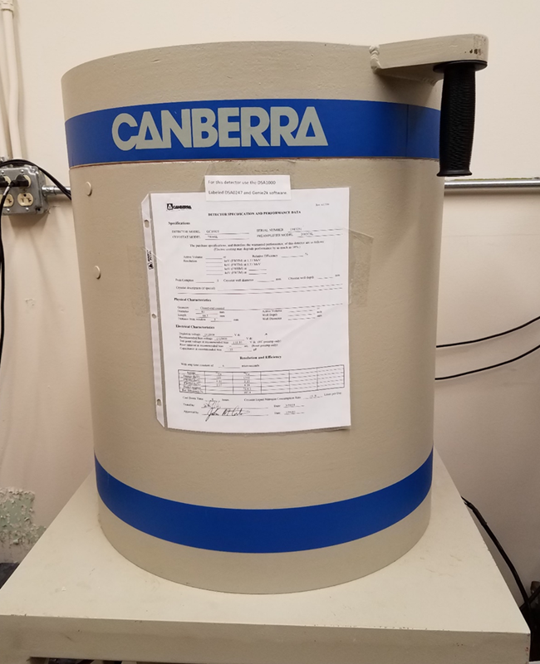
Experiment
Performed by Lt Col O’Day (April 2017)
Eckert & Ziegler Multi-nuclide source
Count time = 24 hours
5 different source positions
Notes:
experiment

Slide 6
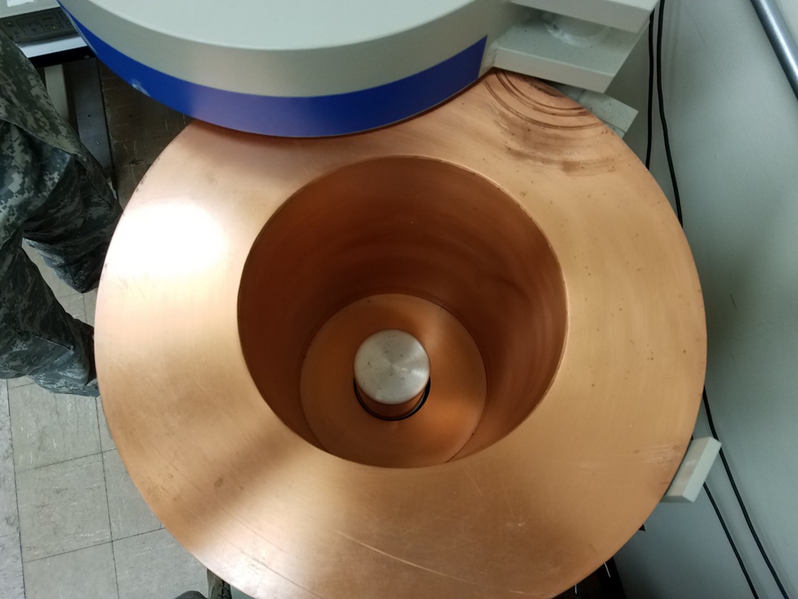
Experimental Setup
Notes:
Visual, copper lining to prevent X-ray/electron backscatter

Slide 7
Experimental Setup
Gamma-Ray Energy [keV] | Nuclide | Activity [µCi] | Gammas per Second
60 | Am-241 | 0.02941 | 391.7
88 | Cd-109 | 0.2707 | 363.6
122 | Co-157 | 0.01019 | 322.7
159 | Te-123 | 0.01403 | 436.1
320 | Cr-51 | 0.3389 | 1236
392 | Sn-113 | 0.05109 | 1227
514 | Sr-85 | 0.06171 | 2247
662 | Cs-137 | 0.04325 | 1362
898 | Y-88 | 0.09633 | 3347
1173 | Co-60 | 0.05101 | 1885
1333 | Co-60 | 0.05101 | 1887
1836 | Y-88 | 0.09622 | 3539
* Energies were kept constant with manufacturer provided documentation
* Source uncertainty for each energy was 3.1%
Notes:
Sufficient Energy Range

Slide 8
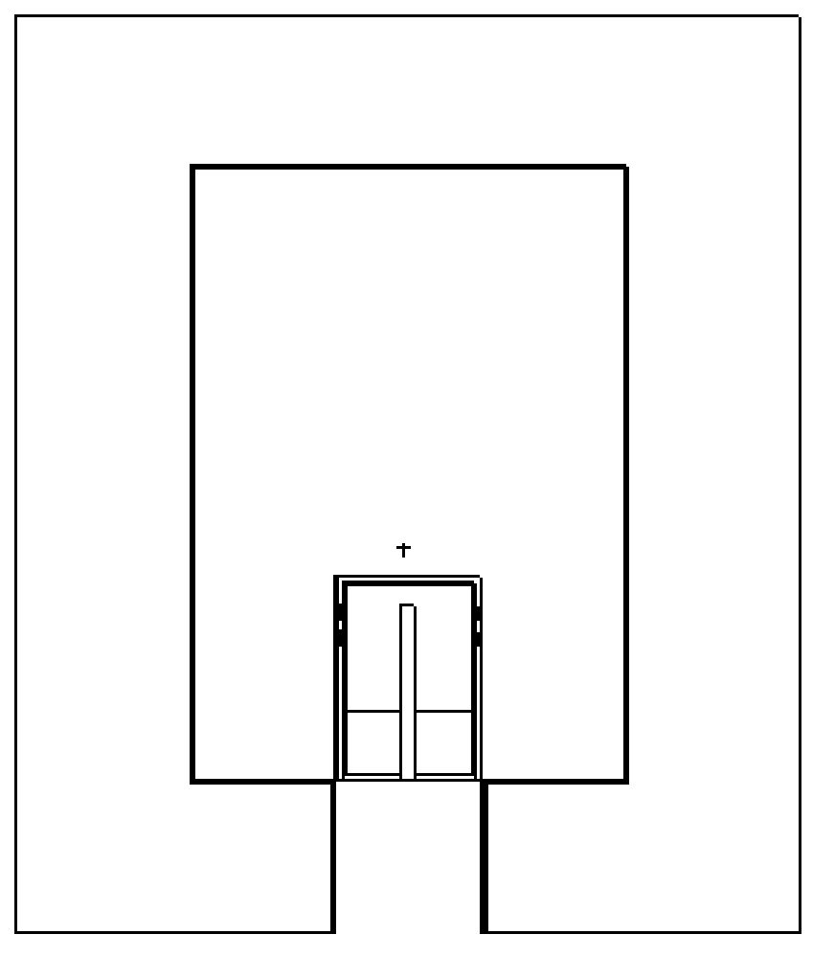
Experimental Setup
Z-axis
G
5
3
A – 13.7385 cm
B – 3.48 cm
C – 4.8885 cm
D – 7.6 cm
E – 20.735 cm
F – 29.7385 cm
G – 9.78 cm
E
F
1
B
2
A
C
4
D
X-axis
(0,0)
Notes:
Visual set up

Slide 9
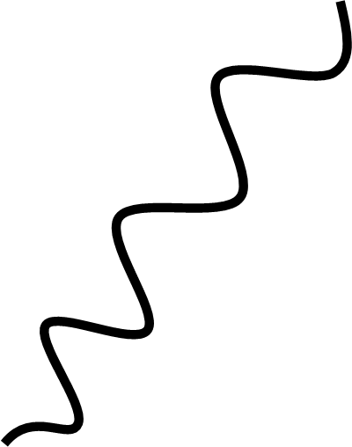

Detector Specifications
Canberra Standard Electrode Ge Detector (SEGe)
Model Number: GC10021
Relative Efficiency $≥$ 100 %
Resolution: 1.20 keV at 122 keV and 2.1 at 1.3 MeV
Coaxial Configuration
P-Type
γ
p+ contact
n+ contact
e-
Notes:
Found on Canberra’s website

Slide 10
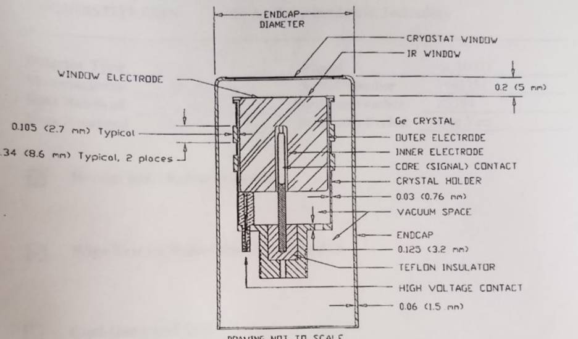
Detector Specifications
Notes:
Spec sheet: nominal values/polishing effects
Approximated clasp location/IR window layout
Ignored: Pin, Teflon, Power cables, top endcap clasp, rounded edges?

Slide 11
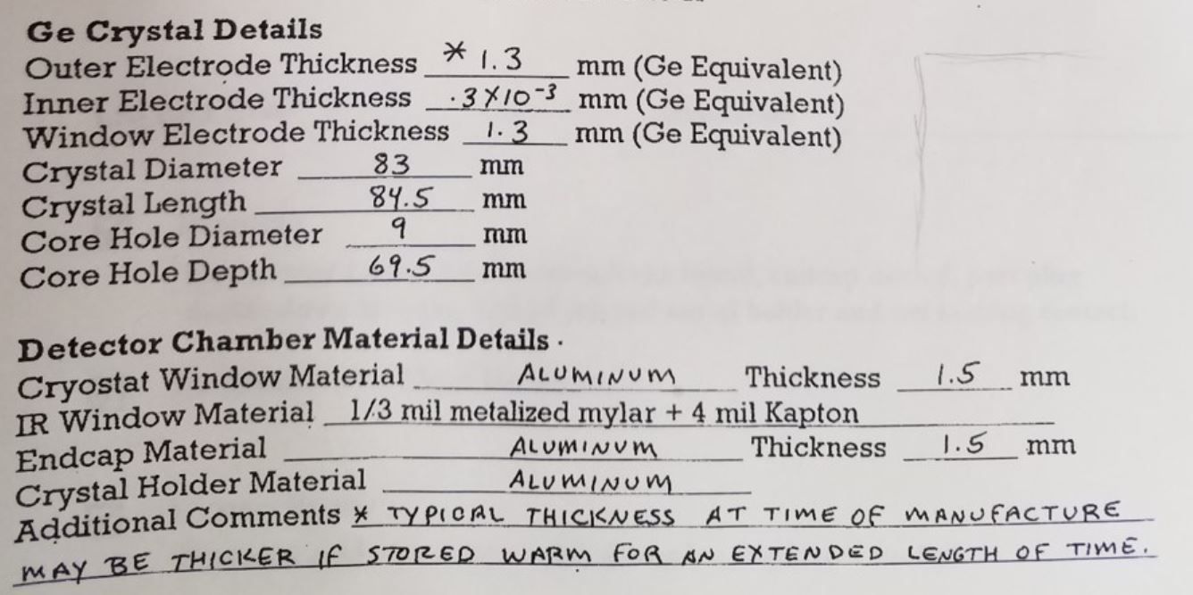
Detector Specifications
Notes:
Outer electrode – Lithium(n+)
Inner Electrode – Boron (p+)

Slide 12
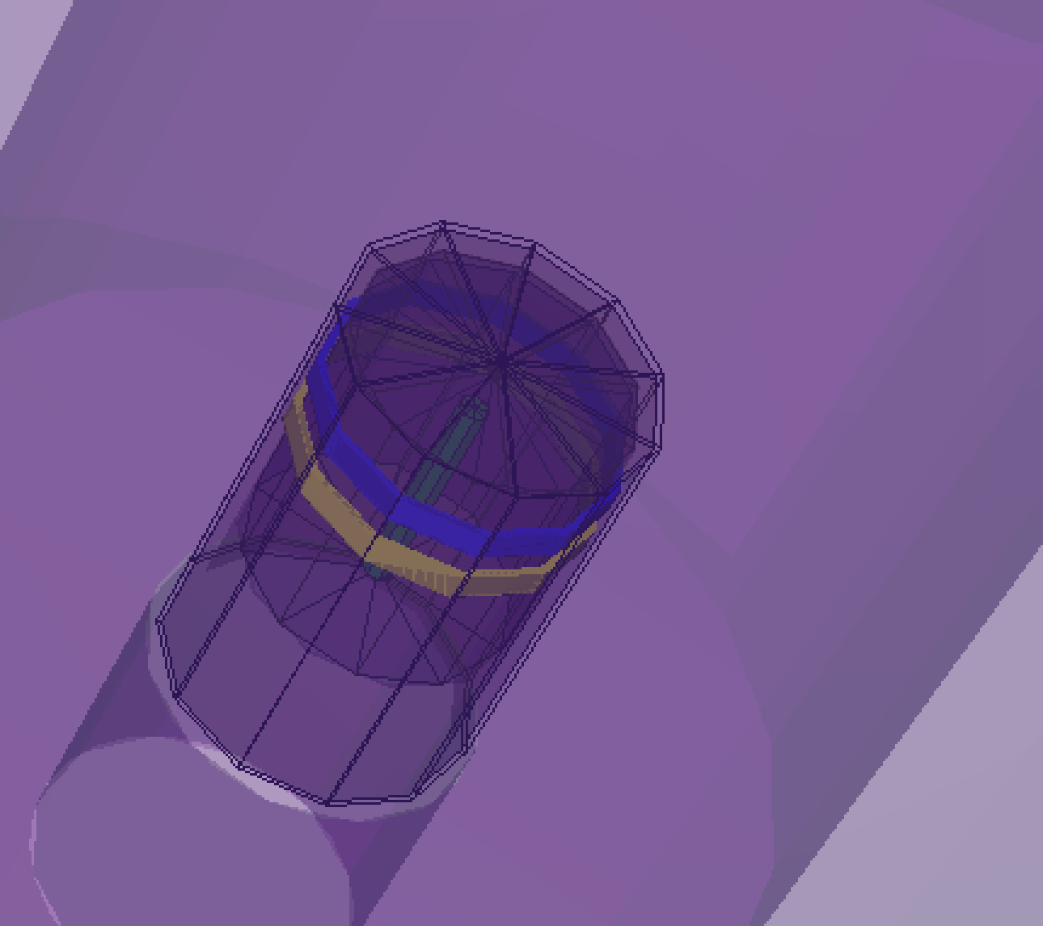
MCNP Model
Notes:
**Aesthetic Effect**

Slide 13
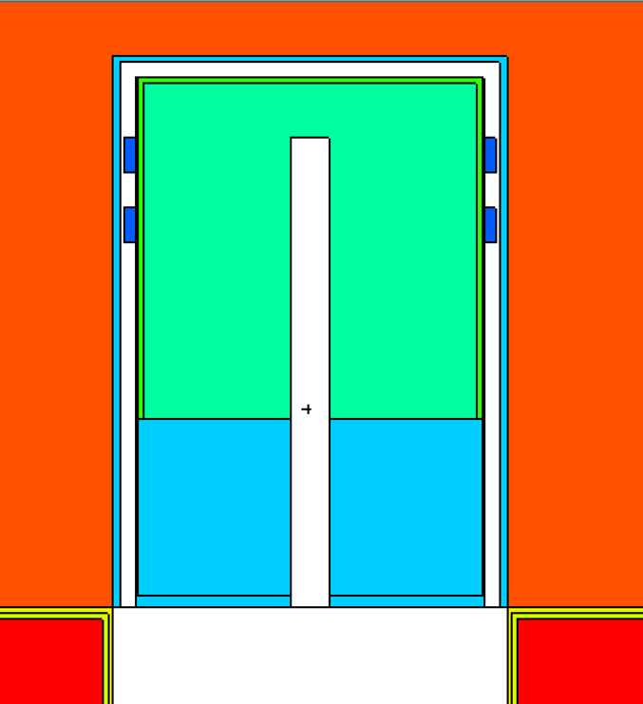
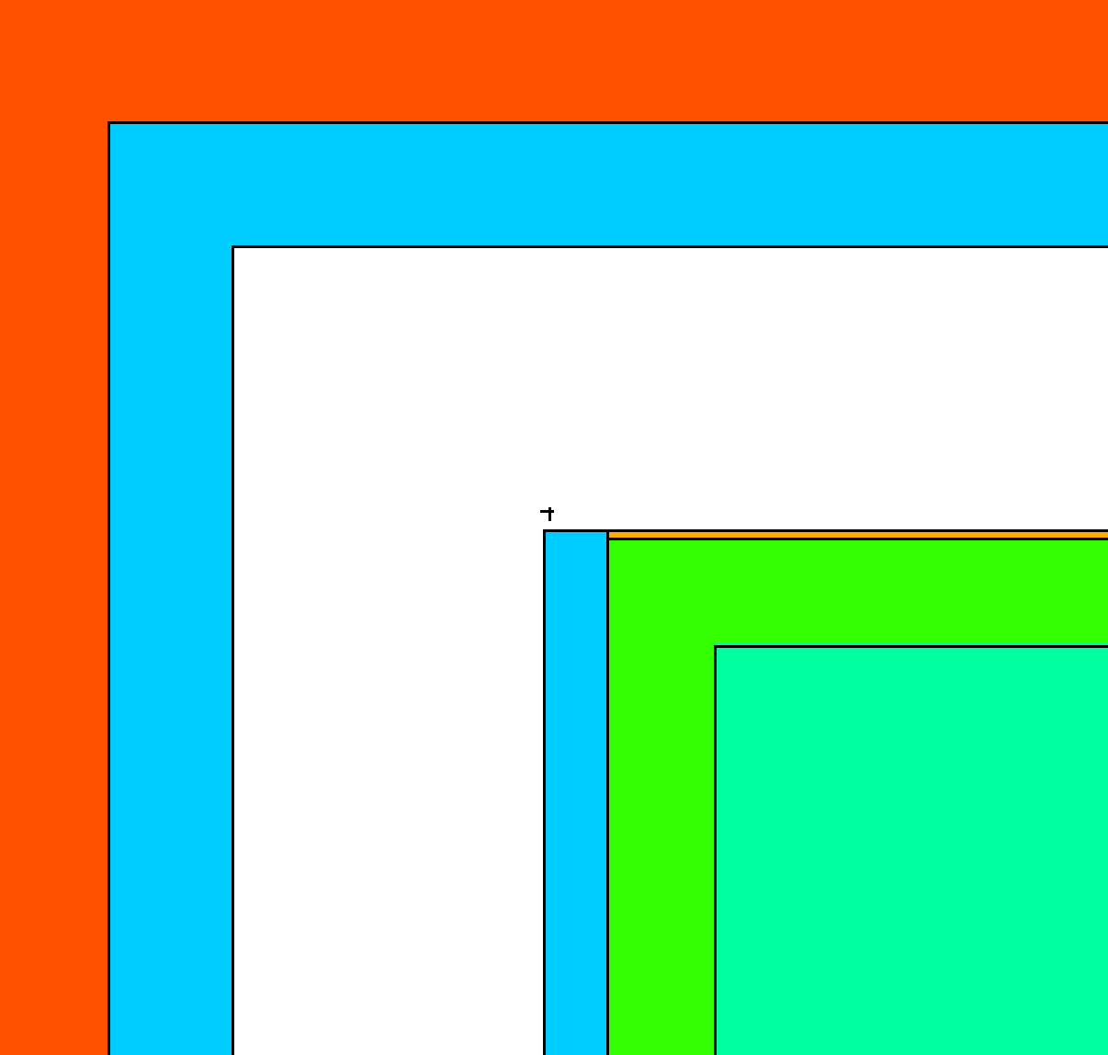
Geometry
Origin: Centered/Bottom of shielding case
Cylinders (~14 CZs)
Planes (~20 PZs)
Notes:
Cylinders/Planes to simplify parameter/size adjustments
Interahcnageable for future models

Slide 14
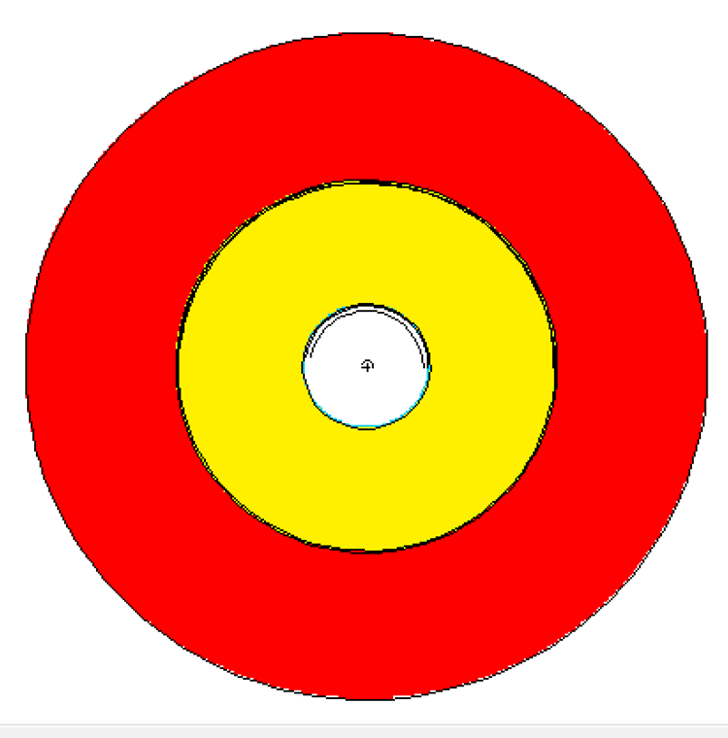
Geometry
Top View:

Slide 15
Materials
Material | Density [g/cm³] | Component(s)
Mylar | 1.38 | IR Window
Aluminum | 2.7 | Detector Housing and Casing
Germanium | 5.32 | Ge Crystal
Lithium | 0.534 | Outer Deadlayer
Boron | 2.73 | Inner Deadlayer
Copper | 8.96 | Shield Lining
Tin | 7.31 | Shield Lining
Kapton Film | 1.42 | IR Window
Air | 0.001224 | Shielding Chamber
Lead | 11.34 | Shielding
Acrylic Glass | 1.19 | Source Encapsulation
Vacuum | --- | Coaxial Space
* All materials from LANLs ACE Data Tables, or PNNLs Compendium of Material Composition Data for Radiation Transport Modeling

Slide 16
Parameters to Adjust
Parameter | Initial Value
Outer Top Deadlayer | 0.13 cm
Outer Sides Deadlayer | 0.13 cm
Ge Crystal Length | 8.32 cm
Kapton Window | 0.01016 cm
Inner Top Coaxial Deadlayer | 0.00003 cm
Inner Sides Coaxial Deadlayer | 0.00003 cm
Top Al Casing Thickness | 0.15 cm
Sides Al Casing Thickness | 0.15 cm
Ge Crystal Density | 5.32 g/cm³

Slide 17
Photon Transport
Only photons
5 MeV upper limit
No Bremsstrahlung
No Coherent scattering
No photo fission
Doppler broadening
Notes:
Cite manual, primer, and PNNL materials

Slide 18
Source Definition
Isotropic point source
12 discrete energies
10⁶ source particles
Gaussian broadening off
Tally:
F8 – Energy Deposition Tally
Ge Crystal (Cell 3)
8192 bins (10⁻⁵ - 3.14344 MeV)

Slide 19
Developer Environment
Windows 10
Required Software:
MCNP
Python
How-to run
Structure
InputDeck – Location of the created MCNP Decks
MCNP_Ouput – Location of the created data
Model – Location of the user created MCNP deck
Experimental Data
FilestoMerge
PythonCode
Notes:
InputDeck – Location of the created MCNP Decks
MCNP_Ouput – Location of the created data
Model – Location of the user created MCNP deck
Experimental Data
FilestoMerge
Required Software:
MCNP - 6
Python – 3
How-to run - Known working with python installed on local C: double click the StartAutomaton.bat
Otherwise use favorite IDE and run the python script

Slide 20
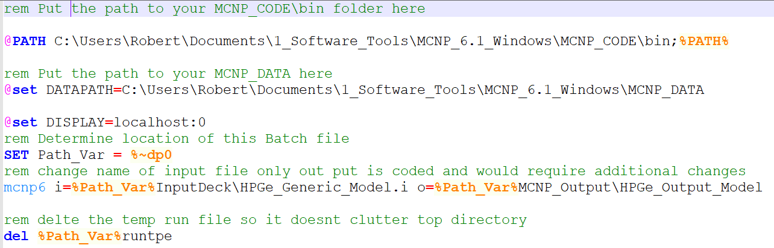
Batch Files

Slide 21
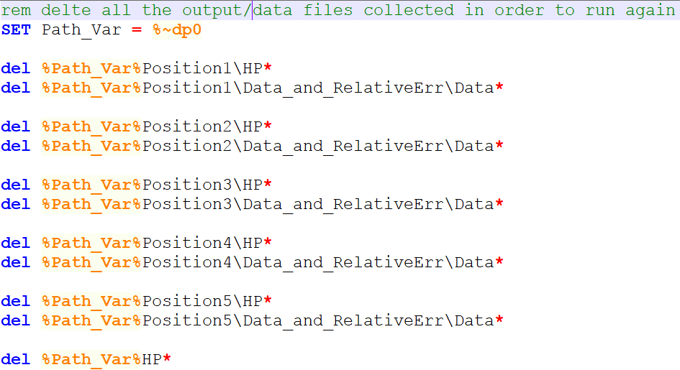
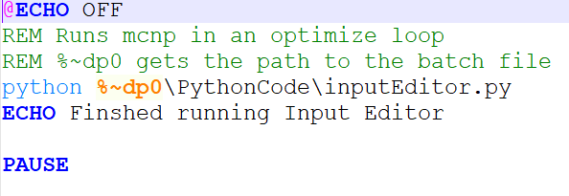
Batch Files

Slide 22
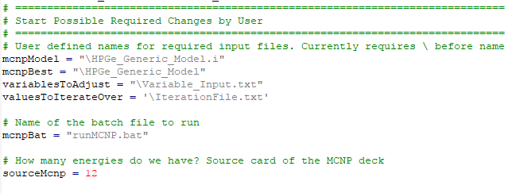
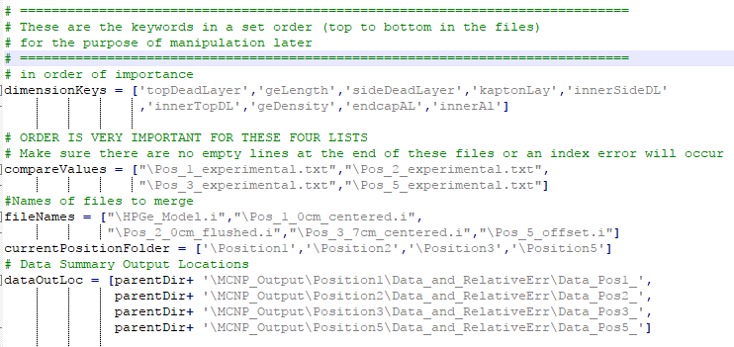
User Changes
Notes:
Even if the user wants to simply duplicate running this file they will need to alter the runMCNP.bat with their datapath to their mcnp data and mcnp bin folders.
First 100 lines of code involves heavy commentary and variables the user would have to alter.
The user also has to edit the runMCNP.bat file if they change the name for the mcnpModel

Slide 23
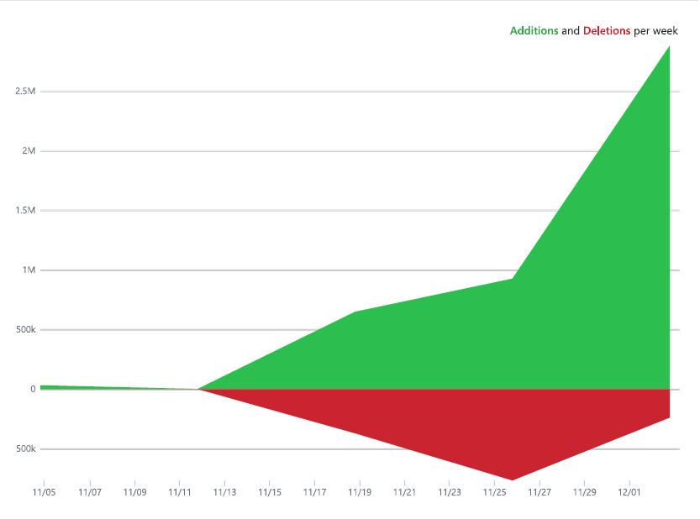
Automated Parametric Optimization Code
Overview
Process
Create Values for the Parameters
Alter the MCNP Input Deck
Run MCNP
Compare the Results
Record Clean and Reset
Notes:
This is the code frequency, just to give some insight on how much was done. It is bloated a little bit since it is probably counting the Data Output files
Simple sweet and to the point. The created values are from 1] the iteration range and 2] the best value out of the previous parameter results, based on lowest Chi Squared value currently.

Slide 24
Parameters to Adjust
Parameter | Initial Value | Lower Bound | Upper Bound
Outer Top Deadlayer [cm] | 0.13 | 0.013 | 0.73899333
Outer Sides Deadlayer [cm] | 0.13 | 0.03 | 0.23
Ge Crystal Length [cm] | 8.32 | 7.474993997 | 9.165002
Kapton Window [cm] | 0.01016 | 0.00516 | 0.11016
Inner Top Coaxial Deadlayer [cm] | 3.00E-05 | 5.67E-06 | 0.00013
Inner Sides Coaxial Deadlayer [cm] | 3.00E-05 | 1.00E-05 | 1.00E-04
Top Al Casing Thickness [cm] | 0.15 | 0.05 | 0.25
Sides Al Casing Thickness [cm] | 0.15 | 0.05 | 0.25
Ge Crystal Density [g/cm³] | 5.32 | 5.29 | 5.32

Slide 25
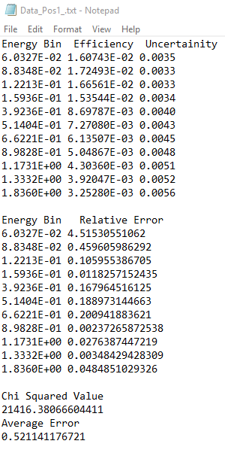
What is Created
After running MCNP the Output file is striped of its
relevant information.
Once acquired the Error and the Chi square
Can be determined
Additionally Plots are able to be created at this point

Slide 26
Before After
Notes:
Include the data from before and after showing how the default values are optimized somewhat. Also include the experimental data. Used relative error since we were trying to get near identical values compared to the given experimental data
Used an average error to simply see if any progress was made without having to look line by line.
Used a Chi Squared value ……….?

Slide 27
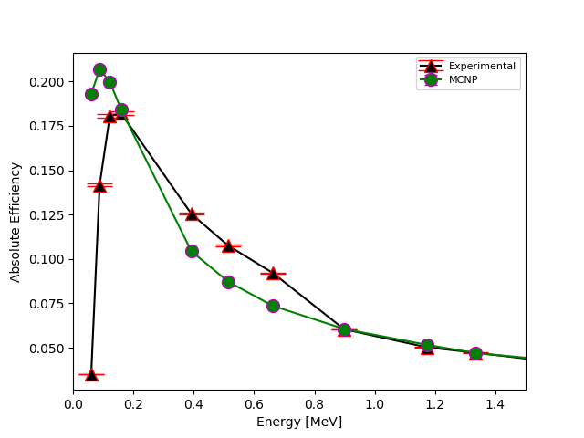
Position 1
Avg Rel Error: 52.1%
Max Rel Error: 452%
Min Rel Error: 0.237%
Notes:
Include all the plots explain that these are showing our results in comparison with the given experimental results. Note that the plots were also automated in their creation.

Slide 28
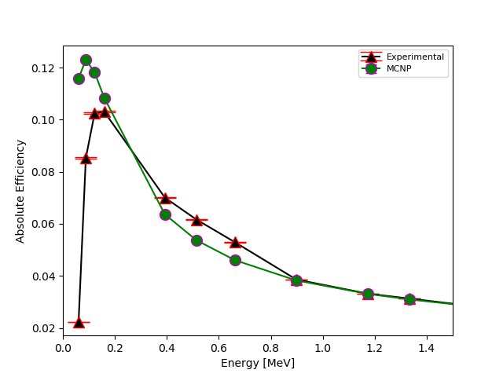
Position 2
Avg Rel Error: 47.8%
Max Rel Error: 423%
Min Rel Error: 0.696%
Notes:
Include all the plots explain that these are showing our results in comparison with the given experimental results. Note that the plots were also automated in their creation.

Slide 29
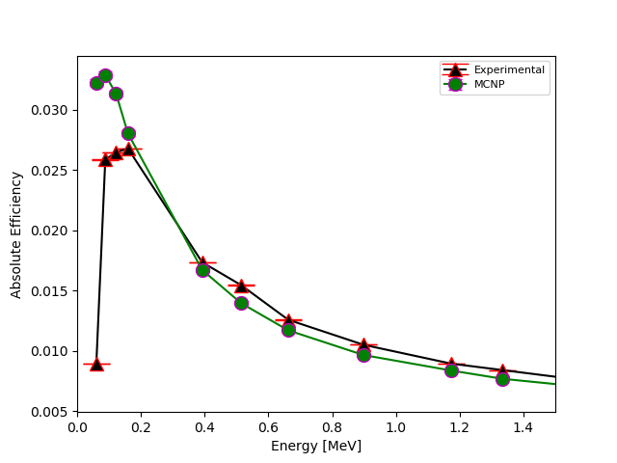
Position 3
Avg Rel Error: 32.6%
Max Rel Error: 259%
Min Rel Error: 5.68%
Notes:
Include all the plots explain that these are showing our results in comparison with the given experimental results. Note that the plots were also automated in their creation.

Slide 30
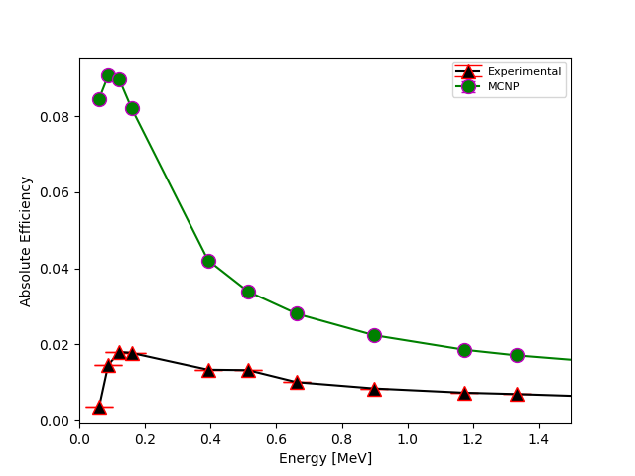
Position 4
Avg Rel Error: 452%
Max Rel Error: 2247%
Min Rel Error: 144%
Notes:
Include all the plots explain that these are showing our results in comparison with the given experimental results. Note that the plots were also automated in their creation.

Slide 31
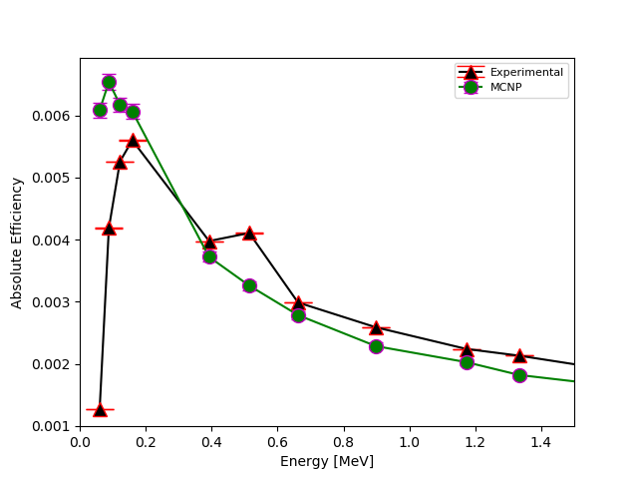
Position 5
Avg Rel Error: 49.4%
Max Rel Error: 380%
Min Rel Error: 8.27%
Notes:
Include all the plots explain that these are showing our results in comparison with the given experimental results. Note that the plots were also automated in their creation.

Slide 32
Optimized Positions
Parameter | Initial Value | Position
 |  | 1 | 2 | 3 | 4 | 5
Outer Top Deadlayer [cm] | 0.13 | 0.73899 | 0.73899 | 0.73899 | 0.73899 | 0.73899
Outer Sides Deadlayer [cm] | 0.13 | 0.23 | 0.23 | 0.23 | 1.35 | 0.23
Ge Crystal Length [cm] | 8.32 | 7.66277 | 7.47499 | 7.47499 | 7.47499 | 7.47499
Kapton Window [cm] | 0.01016 | 0.11016 | 0.11016 | 0.11016 | 0.05766 | 0.11016
Inner Top Coaxial Deadlayer [cm] | 3E-05 | 13E-05 | 6E-05 | 6E-05 | 10E-05 | 6E-05
Inner Sides Coaxial Deadlayer [cm] | 3E-05 | 2E-05 | 6E-05 | 7E-05 | 0.001 | 7E-05
Top Al Casing Thickness [cm] | 0.15 | 0.25 | 0.25 | 0.25 | 0.05 | 0.25
Sides Al Casing Thickness [cm] | 0.15 | 0.05 | 0.05 | 0.05 | 0.27 | 0.25
Ge Crystal Density [g/cm³] | 5.32 | 5.32 | 5.32 | 5.35 | 5.32 | 5.3425
- Larger - Smaller
Notes:
Include all the plots explain that these are showing our results in comparison with the given experimental results. Note that the plots were also automated in their creation.

Slide 33
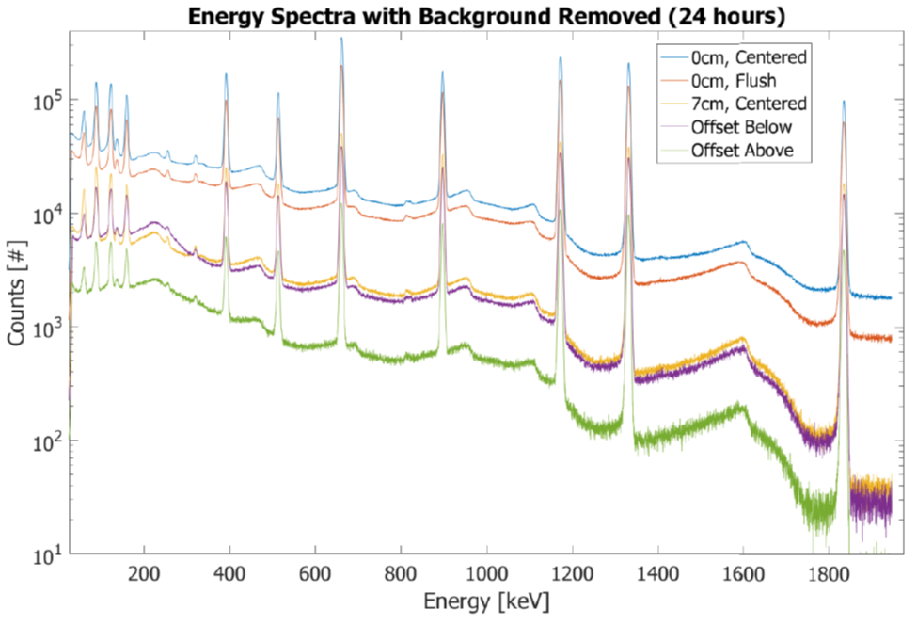
Reasons for Possible Error
Notes:
Lower energy photons are more sensitive to attenuation
Between 200-500 keV includes both the: Backscatter and annihilation peak
Backscatter – recoiled Compton scattered photon
Annihilation – 0.511 MeV photon from pair production/positron annihilation
Knolls: backscatter peak @ 184 keV for Cs-137, Comton Edge @ 662-184 = 477 keV

Slide 34
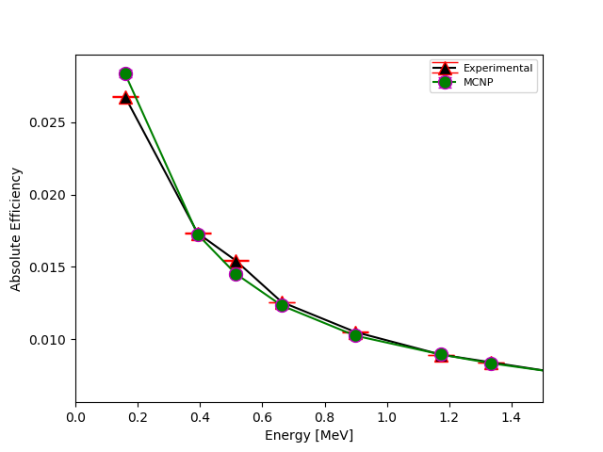
Position 3 Modified
Avg Rel Error: 2.38%
Max Rel Error: 5.95%
Min Rel Error: 0.07%
Notes:
Include all the plots explain that these are showing our results in comparison with the given experimental results. Note that the plots were also automated in their creation.

Slide 35
Position 3 Modified
Parameter | Initial Value | Position
 |  | 3 | 3 Adjusted
Outer Top Deadlayer [cm] | 0.13 | 0.73899 | 0.97535
Outer Sides Deadlayer [cm] | 0.13 | 0.23 | 0.13
Ge Crystal Length [cm] | 8.32 | 7.47499 | 8.60166
Kapton Window [cm] | 0.01016 | 0.11016 | 0.13016
Inner Top Coaxial Deadlayer [cm] | 0.00003 | 6E-05 | 50E-05
Inner Sides Coaxial Deadlayer [cm] | 0.00003 | 7E-05 | 5E-05
Top Al Casing Thickness [cm] | 0.15 | 0.25 | 0.18333
Sides Al Casing Thickness [cm] | 0.15 | 0.05 | 0.25
Ge Crystal Density [g/cm³] | 5.32 | 5.35 | 5.35
Notes:
Include all the plots explain that these are showing our results in comparison with the given experimental results. Note that the plots were also automated in their creation.

Slide 36
Conclusion
The optimization method can represent the efficiency between energies of 0.159-1.836 MeV with a relative difference of 5.9%, for sources 7 cm above the detector
Improvements are needed for-off centered sources
Unable to match low energy photon attenuation with less than a relative difference of 100%
More experimental measurements need to be taken
Further evaluation of internal components

Slide 37
Future Work
Reach a relative percent difference of less than 1%
Increase adjustable parameters/more realistic
Obtain more information about internal components of HPGe
Gather more experimental data for comparison
Include more realistic radiation transport physics to reproduce experimental spectra
Apply automated optimization code to other detectors.
Explore other means for optimization

Slide 38
Summary
Project Goals
Previous Work
Experiment
MCNP Model
Parametric Optimization Code
Results
Conclusions
Future Work

Slide 39
Acknowledgements
Provided project assistance, Captain James Bevins, AFIT
Provided experimental data, Lt Colonel Buck O’Day, AFIT
HPGe Template provided by, Captain James Bevins, AFIT; Mr. Will Kable LLNL;

Slide 40
References
[1] R. M. Keyser, "Resolution and Sensitivity as a Function of Energy and incident Geometry for Germanium Detectors," Nuclear Instruments and Methods in Physics Research Section B: Beam Interactions with Materials and Atoms, vol. 213, pp. 236-240, 2004.
[2] R. G. Helmer, R. G. Hardy, V. E. Iacob, M. Sanchez-Vega, R. G. Neilson and J. Nelson, "The use of Monte Carlo Calculations in the Determination of a Ge Detector Efficiency Curve," Nuclear Instruments and Methods in Physics Research A, vol. 511, pp. 360-381, 2002.
[3] W. F. R. R. K. M. D. O. S. C. A. C. A. X. d. S. Guilherme J. de S. Corrêa, "COMPUTATIONAL MODELING OF A HIGH PURITY GERMANIUM," in International Nuclear Atlantic Conference, Belo Horizonte,MG, Brazil, 2011.
[4] G. F. Knoll, Radiation Detection and Measurement, Hoboken, NJ: John Wiley & Sons, Inc., 2010.
[5] D. K. P. S. J. G. M. Jeremy Lloyd Conlin, "Listing of Available ACE Data Tables," Los Alamos National Laboratory, Los Alamos National Laboratory, 2013.
[6] C. G. R. P. R. R. R. W. I. RJ McConn Jr, "Compendium of Material Composition Data for Radiation Transport Modeling," Pacific North Western National Laboratory, Pacific North Western National Laboratory, 2011.
[7] R. E. F. J. K. Shultis, "An MCNP Primer," Department of Mechanical and Nuclear Engineering, Manhattan, KS, 2011.

Slide 41
Questions?

